Slide 1
一种世界通用语言
人们普遍认为 It is __________ accepted that ..
universality 普遍性
crucial
be crucial to/for sth
……是至关重要的
_________ important
一个关键因素
It is crucial that… sb (should) do sth.
a universal language
universally
vital, critical
be of crucial importance
crucially
a crucial factor

Slide 2
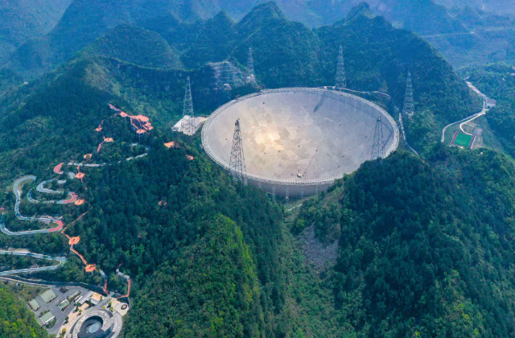
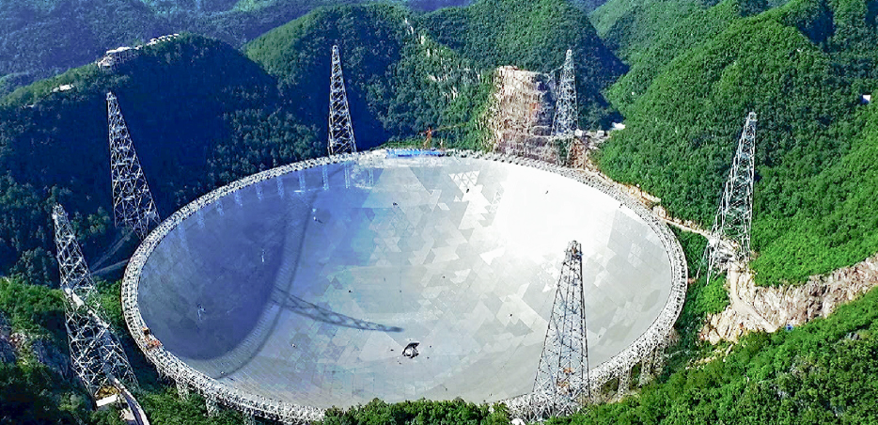
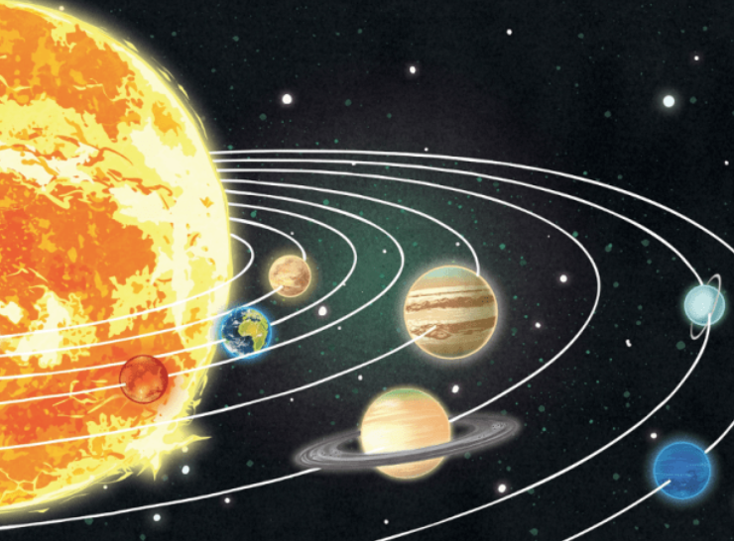
一颗新的人造卫星被送上了环绕地球的轨道。
A new satellite has been put/launched into orbit around the earth.
a space station in orbit round the moon 在轨道上
The earth takes a year to orbit (around) the sun.
orbiting
Five-hundred-meter Aperture Spherical radio Telescope
500米口径球面射电望远镜

Slide 3
merely
It took her a mere 20 minutes to work it out.
The mere thought of eating made her feel sick.
她一想到吃饭就觉得恶心。
他的在场就足以让她感到害怕了。
_____ _____ ________ made her feel afraid.
The merest hint of smoke is enough to make her feel ill.
only, simply
His mere presence

Slide 4
(admin) 管理，行政
the Trump Administration
administration costs
the day-to-day administration of a company
administrator
an administrative assistant
administer 管理，治理 a charity/justice/the law
an advertising agency
a travel agency 旅行社
a travel agent 旅行代理人
Notes:
行政费用
公司的日常管理工作
行政人员

Slide 5
The committee _______________________ ten members.
老年人在那些生活贫困的人中占有很大的比例。
Older people comprise a large proportion of those living in poverty.
make up/account for
is comprised of/comprises
is made up of
is composed of
consists of
Notes:
她急切地端详着他的脸。

Slide 6
I scanned (through) the list quickly for my name.
1) 快速浏览 glance at/through
She scanned his face anxiously. 2) 细看 examine
She had a quick scan of the list.
3) 扫描
扫描你的大脑
have your brain scanned
have a brain scan

Slide 7
foundation
The builders are laying the foundations of the new school.
尊重是婚姻的牢固基础。
Respect provides a solid foundation for marriage.
The rumour is totally without foundation.
The organization has grown enormously since its foundation in 1955.
founding, establishment
Notes:
basis

Slide 8
plain to see / It is plain that …
He is a liar, plain and simple.
a plain and elegent dress
plain food
He made it plain (to sb) that we should leave.
明确表示
to be plain with you, ...
in plain words
a politician with a reputation for plain speaking
说话直率出了名的一个政治人物
the plains
Notes:
朴素淡雅的连衣裙
清淡的食物、原味酸奶
用直白的语言
他明确表示要我们离开。
坦白讲 be plain about sth

